Slide 1
Favorable Findings – Critical Error –
Significant Change – RVSR Task Based Quality Review Checklist
Descriptor “The decision maker did not identify and properly document applicable favorable findings”
Will be changed from a non-critical to a critical error
This change will be implemented sometime in 3rd Quarter of FY20
Notice will be provided 30 days prior to implementation
38 CFR 3.104(c)
M21-1 III.iv.2.B.5
M21-1 III.iv.5.A.1.f
M21-1 III.iv.6.C.5.f

Slide 2
What Are Favorable Findings
An element that is met and conceded getting you one step closer to being able to grant the benefit sought
Not predicated on scheduling a VAE, but at least one element is met if it was properly scheduled

Slide 3
Favorable Findings Helpful Hints – SC
Is the Veteran claiming SC for his/her condition based on military service
Incurrence: Was there a qualifying event, injury or disease during service
No: No favorable finding for this element
Yes: Favorable finding: When and where did you find this information
Diagnosis: Does the Veteran have a current diagnosis of the condition being denied
No: No favorable finding for this element
Yes: Favorable finding: What is the date of diagnosis, source & date are you using
Nexus: Is there a positive opinion with rationale of record
No: No favorable finding for this element
Yes: Favorable finding: What source and date are you using

Slide 4
38 CFR 3.303 Example
Claim for direct SC for low back pain
STRs show in-service event: lumbar spine injury
Proper VAE/MO scheduled
VAE shows dx lumbar strain with MO not related to service
SC denied for lumbar strain (claimed as low back pain)
What are the favorable findings?
In-service event of lumbar spine injury jumping off a tank on June 1, 2002
Current diagnosis of lumbar strain in VAE dated March 11, 2020

Slide 5
Documenting Favorable Findings
Favorable Findings Tab in VBMS-R must be used to document
Excel document showing favorable finding drop-downs is exact duplicate of drop-downs in this Tab
The finding must be specific by using a combination of the pre-populated VBMS-R text, supplemented with appropriate concise free text
The evidence shows that a qualifying event, injury or disease had its onset during your service. On the DD214, your MOS of Infantryman confirms a high probability of noise exposure.
Free text should be no more than one or two sentences, at most
If you are typing more than two sentences, it is too much and/or not appropriate

Slide 6
Inappropriate Free Text Example
You have been diagnosed with a disability. VA examination dated 01/17/2019 shows left eye functional loss of vision. Medical opinion from Michael Monson, OD shows a diagnosis of central corneal opacity, left eye likely causing decrease visual acuity also vitral degeneration and corneal dystrophy. And opined corneal scar from metal in eye during service is more likely than not related to military service. Service treatment records show a piece of metal fell and hit your left eye and FB in left eye could not be gathered or swabbed and you were treated with antibiotic and a steroid and patch. Service treatment record dated 11/30/1962 shows you reported blurred vision in the left eye but it had cleared up. Vision testing done 12/31/1962 showed 20/25 normal vision in the left eye. Service treatment record dated 02/63 showed FB complaint, no damage to left eye was found. X-ray dated 08/09/63 for FB, none were found. Eye exam dated 10/14/65 was found to be normal.

Slide 7
What Isn’t a Favorable Finding
Favorable findings are NOT discussions of the facts of the case (even facts that appear favorable, such as a private medical opinion, if that fact is not accepted as a conceded element)
Favorable findings are NOT negative findings
Examples of what would NOT be a favorable finding:
The STRs do not show evidence of your claimed condition
The private medical opinion provided a nexus, but we are not accepting that nexus as it does not include rationale, and the VA medical opinion does

Slide 8
Correcting AMA Error Citations
The following verbiage will be used within the new rating decision and related notification letter:
Providing missed laws and regulations: The purpose of this rating decision is to provide you with additional laws and regulations that are applicable to our decision on your claim but were not included in our previous decision of ____ (date).
Providing favorable findings: The purpose of this rating decision is to explain the favorable findings associated with your claim for ____ (issue) but were not included in our previous decision of ___ (date).

Slide 9
Refresher Courses
AMA Improved Decision Notices - Rating Decisions: TMS # 4491280
Appeals Modernization Act 201: TMS # 4491236
Favorable Findings (VBMS-R) and Supplemental Claims: TMS # 4500202
AMA Supplemental Training in Adobe Prime: TMS # 4500996
https://captivateprime.adobe.com/app/learner?accountId=27356#/course/1126260
AMA FAQs

Slide 10
VBMS-R User Tips for Correcting CUEs
Recent M21-1 updates have clarified procedures for correction of the record in CUE scenarios associated with administrative error
M21-1 III.iv.8.B
M21-1 III.iv.8.E
M21-1 IV.ii.3.A
Two significant clarifications
Update the codesheet so that it reads how it should have read had no error been made
Provide due process for past reductions even if current payments are not affected

Slide 11
General Guidance
General best practice:
Use VBMS-R to generate the issue and decision for the final rating
THEN return to the master record to correct the codesheet
M21-1 III.iv.6.C.5.a requires explanation of effective dates
3 main scenarios
Severance
Reduction affecting current payment
Past reduction not affecting current payment

Slide 12
Scenario 1
Severance
Facts:
SC was erroneously established for a right knee disability effective 04/16/2016
Evidence did not establish service incurrence
Rating decision and notification letter providing due process was completed 12/29/2019
The claimant did not provide any evidence during the due process period
Today we are rating the final reduction
The rating has been completed in VBMS-R up to the point of completion of the decision entry and narrative creation

Slide 13
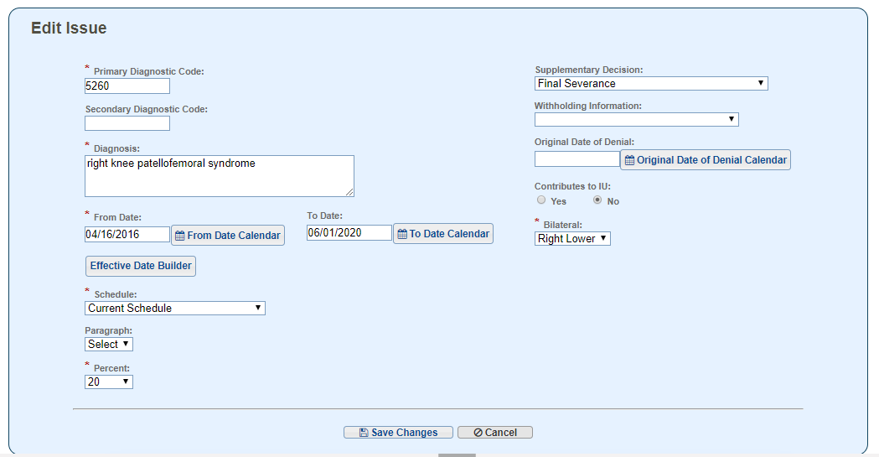
Issue Management
Diagnosis Information Screen:
Enter effective date of severance in To Date
Select Final Severance from the Supplementary Decision menu
DO NOT change Decision Basis or other information at this point.

Slide 14
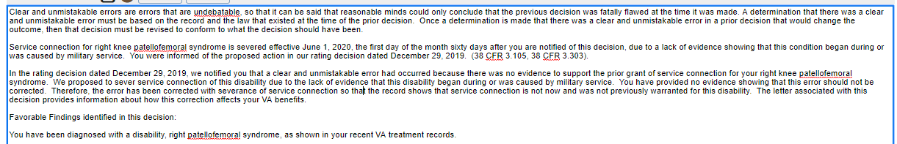
Issue Management
Complete rating narrative
Narrative text (supplement as necessary)
Favorable findings
Reference laws
Include explanation of effective date

Slide 15
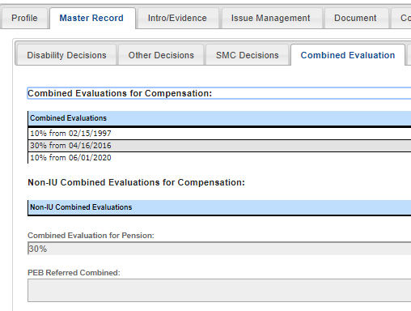
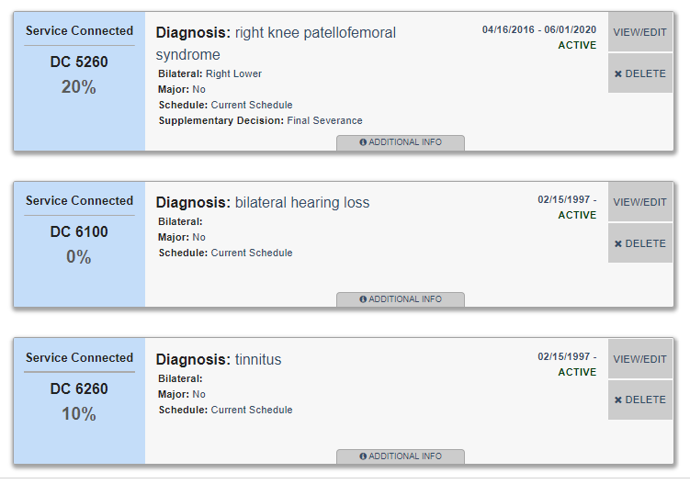
Current Master Record

Slide 16
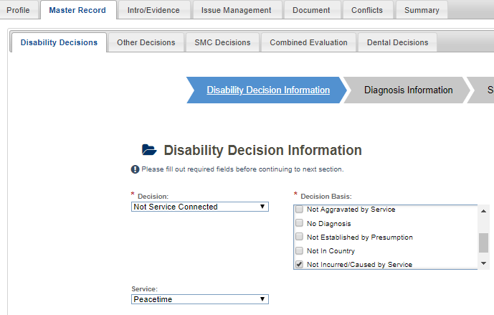
Correct the Master Record
Return to the Master Record
Edit the severance issue on the Disability Decision Information screen
Decision field: change to Not Service Connected
Decision Basis field: change to Not Incurred/Caused by Service (or whatever basis is appropriate for the issue being addressed)
Service field: re-enter appropriate service
Save make no other changes

Slide 17
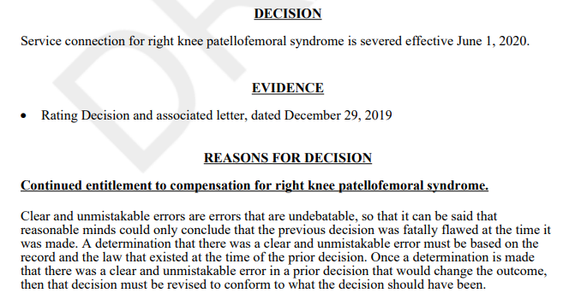
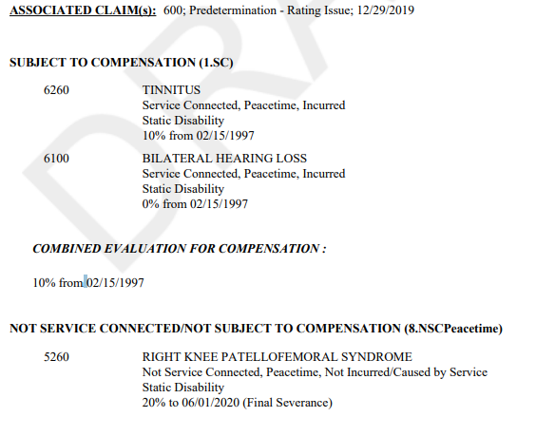
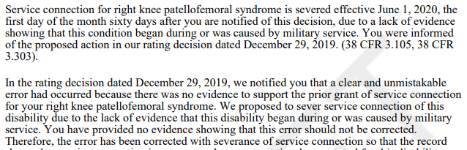
Severance Narrative & Codesheet

Slide 18
Scenario 2
Reduction affecting current payment
Facts:
Rating decision dated October 5, 2017, granted service connection for right knee patellofemoral syndrome at 20 percent effective January 12, 2017
A rating decision dated December 23, 2019 (with due process letter on the same date), properly identified a CUE for assigning an incorrect evaluation of 20 percent and proposed to reduce the evaluation to 10 percent
The current combined evaluation will be reduced from 20 to 10 percent
Today we are rating the final reduction

Slide 19
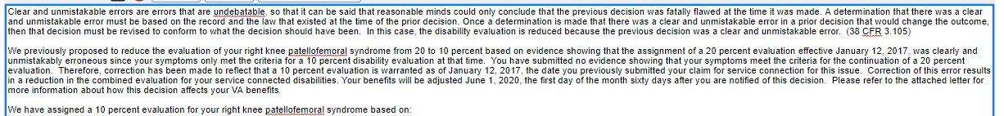
Generating Issue/Decision
Generate the final reduction in Issue Management in VBMS-R as normal, adding necessary effective date and reasons and basis information and applicable laws, as needed

Slide 20
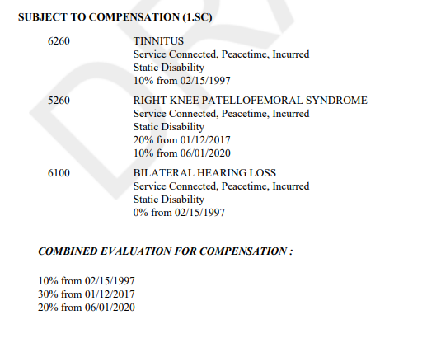
Why Must the Codesheet Be Corrected?
Without correction of the codesheet, the combined evaluation continues to be calculated as 30 percent from January 12, 2017, for this and future decisions
Incorrect Codesheet

Slide 21
Procedures to Correct the Codesheet
Return to the Master Record
Edit the Diagnosis Information screen to change the effective date of the 10 percent evaluation to reflect the correct effective date for the decision had the error not occurred (January 12, 2017)
Delete the information from the Supplementary Decision field
Delete the 20 percent evaluation information

Slide 22
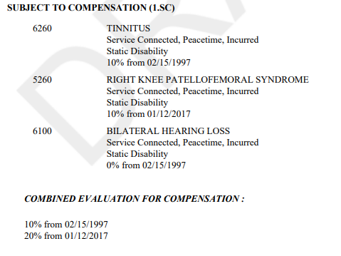
Corrected Codesheet
Following correction of the Master Record
the narrative will continue to generate with the proper notification for the Veteran, and
the codesheet will generate with the CUE corrected and proper combined evaluation information

Slide 23
Scenario 3
Past reduction not affecting current payment
Facts
A prior rating decision granted service connection for residuals of left elbow fracture with a 20 percent evaluation assigned effective July 9, 2017
This was the Veteran’s only service-connected disability at that time
Thereafter, a rating decision dated June 15, 2019, granted service connection for PTSD with a 50 percent evaluation effective March 22, 2019
A rating decision and due process notification dated December 15, 2019, properly proposed to reduce the elbow disability’s 20 percent evaluation to 10 percent
If this reduction occurs, the combined evaluation will be 10 percent from July 9, 2017 to March 22, 2019
Sixty percent will continue from March 22, 2019
We are completing the final reduction rating today

Slide 24
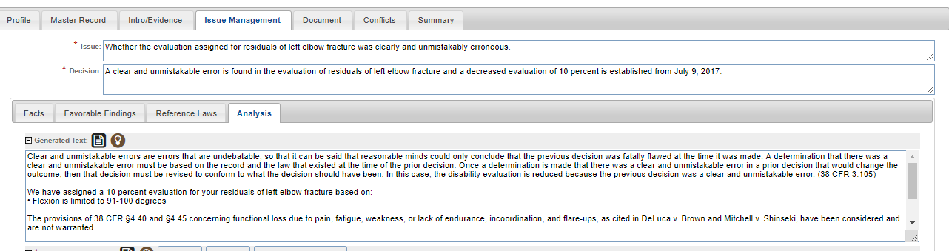
Edit Generated Language
There is no perfect way to enter this decision in VBMS-R
Entered here as final reduction effective July 9, 2017, to generate CUE language
Edit generated language to provide proper information

Slide 25
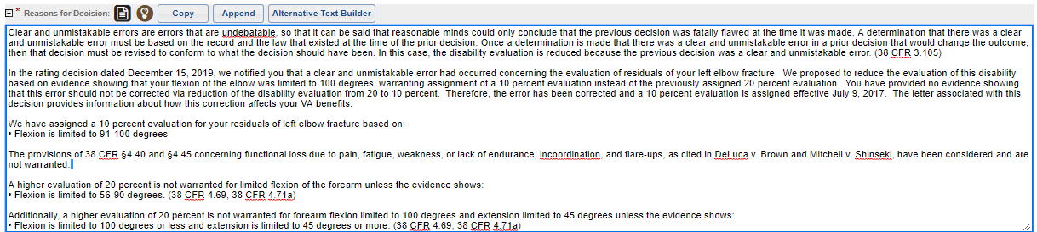
Provide Correct Information in the Narrative
Suggestions:
Leave discussion of payments to the notification letter
Provide the specifics of the error without extensive discussion (assuming that was provided in the proposal)

Slide 26
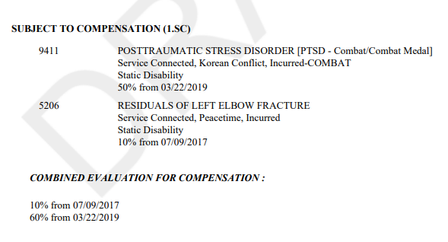
Correct the Codesheet
Update the codesheet so that it reads how it should have read had no error been made
For this example, correction involved removing the 20 percent evaluation for the elbow

Slide 27
Final Reminders
Leave discussion of payment details to authorization
When current benefits change, use the effective date of the benefit change in the decision text and explain that date in the narrative
Also explain how the record is corrected for the CUE
You may include a note on the codesheet annotating that this is a CUE due to administrative error and no O/P should be created
This is discretionary, but if it is unclear that this is the situation, then the note may be helpful
Be clear and specific in your narrative
Review all generated text to ensure accuracy
Often, there is no single correct way to address a CUE in VBMS-R
Use the system optimally for generation of situation-appropriate generated language

